Slide 1
Ask a question/
Identify a problem
Science & the
Scientific Method
Construct a hypothesis
Perform an experiment
Analyze data
Create conclusion
unsupported
supported

Slide 2
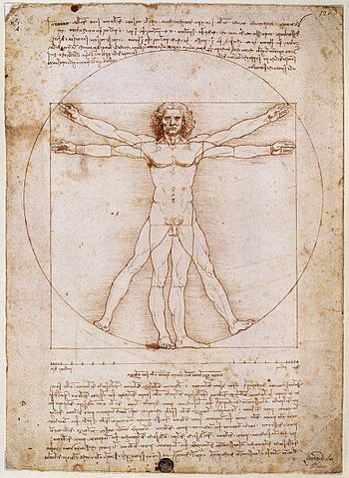
What is Science?
Science: Process that produces information about natural world

Slide 3
What is Science?
Science: Process that produces information about natural world
Objective
Reality
Bias idea

Slide 4

What is Science?
Science: Process that produces information about natural world
Objective
Repeatable

Slide 5
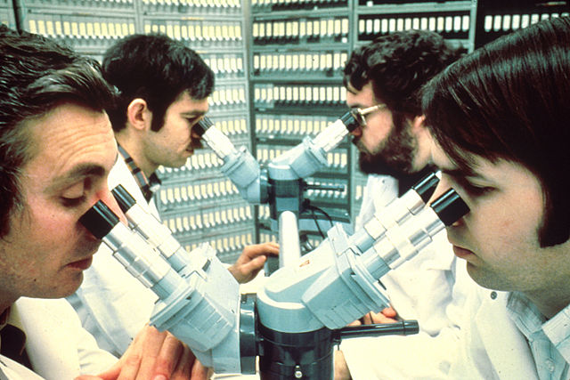
What is Science?
Science: Process that produces information about natural world
Objective
Repeatable
Tools and skills:
  Observation
Microscope observations

Slide 6
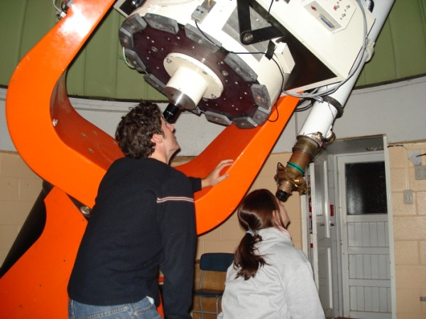
What is Science?
Science: Process that produces information about natural world
Objective
Repeatable
Tools and skills:
  Observation
Telescope observations

Slide 7
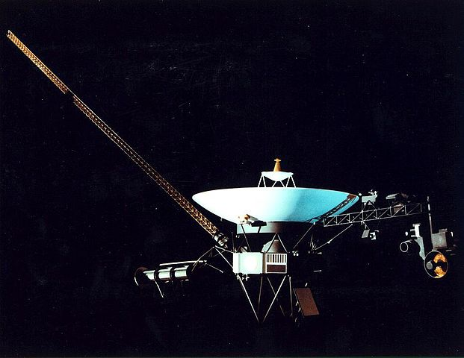
What is Science?
Science: Process that produces information about natural world
Objective
Repeatable
Tools and skills:
  Observation
Voyager I and Voyager II probes have observed the solar system and beyond

Slide 8
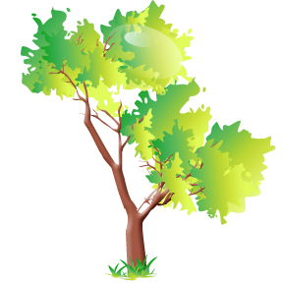

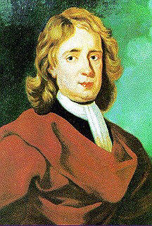
What is Science?
Science: Process that produces information about natural world
Objective
Repeatable
Tools and skills:
  Observation
A force in nature… gravity

Slide 9
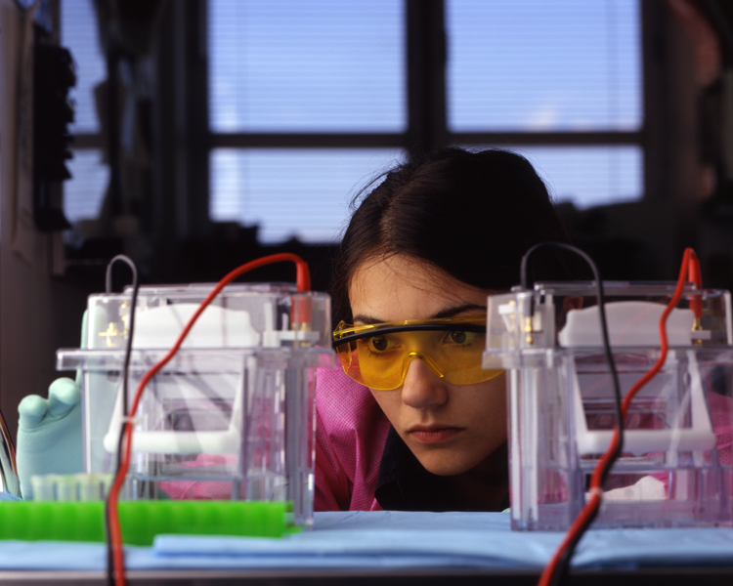
What is Science?
Science: Process that produces information about natural world
Objective
Repeatable
Tools and skills:
  Observation
  Experimentation
DNA experimentation

Slide 10
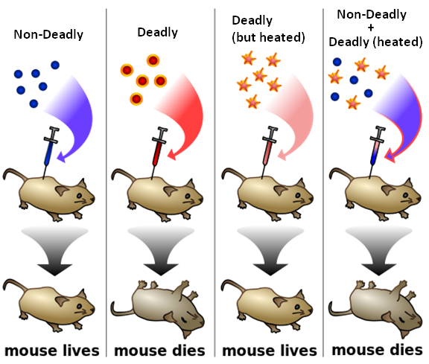
What is Science?
Science: Process that produces information about natural world
Objective
Repeatable
Tools and skills:
  Observation
  Experimentation
Data gathered by the “scientific method”
1928: Frederick Griffith’s experiment taught us bacteria can transfer genetic information

Slide 11
Scientific Method
Ask a question/
Identify a problem
Defined: Series of steps to collect information or solve problems
  Problem/Observation
  Hypothesis
  Experimentation
  Data Analysis
  Conclusion
  Repeat
Construct a hypothesis
Perform an experiment
Analyze data
Create conclusion
unsupported
supported

Slide 12
Observation and Hypothesis
1st step: Problem/Observation
  Example: I seem to sleep better when I play relaxing music.
2nd step: Create hypothesis
  If…then statement
  Example: If there is relaxing music playing, then I will sleep longer.

Slide 13
Experiment
Two parts to an experiment:
1) Control group
  Receives no special treatments
  Used as comparison
  The “normal” group
2) Experimental Group
  Same as control group, but with one difference…
  Independent variable
    The one factor that differs from the control group
    The factor you are testing
  Dependent variable: Data gathered

Slide 14
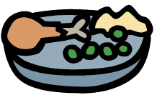
Control group vs. Experimental Group
Does the data support the hypothesis?
Independent Variable
Yes. Since all other factors are the same, the music must have caused the extra sleep.
Results: Sleep continuously for 6.2 hours
Dependent Variable
Results: Sleep continuously for 7.5 hours

Slide 15
How about this situation?
Does the data support the hypothesis?
Unknown. The data is invalid.
There are too many variables in this experiment.
There are other possible explanations to explain the extra sleep.
Results: Sleep continuously for 6 hours
Results: Sleep continuously for 8 hours

Slide 16
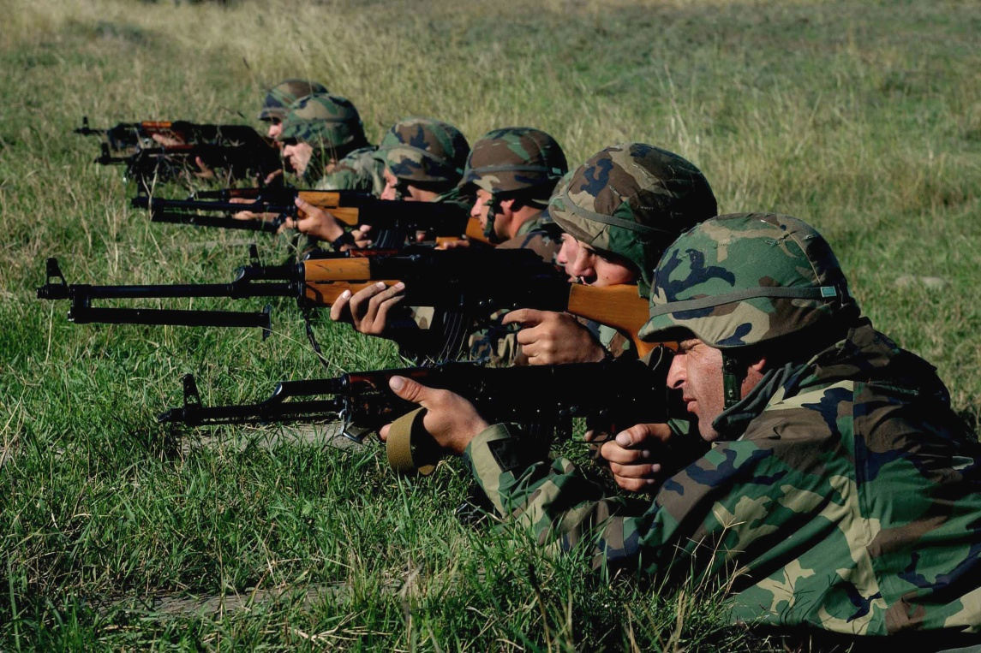
The United States military wants to see if soldiers with only 4 hours of sleep can operate at the same level as those who normally get 7 hours of sleep. One hundred solders are allowed to only sleep for 4 hours a night and another hundred are allowed to sleep for 7 hours a night. During the day, the soldiers are tested for marksmanship on the firing range.
.
.
.
Soldiers with 7 hours sleep
Name the control group _________________________________________________
Name the experimental group ____________________________________________
Name the independent variable __________________________________________
Name the dependent variable ____________________________________________
Soldiers with 4 hours sleep
Amount of sleep given
Score on the firing range

Slide 17
This farmer wants to test a new fertilizer for his crops. He sections off two large areas of his field. In section A, he waters his crops as usual and uses his normal fertilize, Grow-Rite. In section B, he waters his crops as usual and but adds Ever-Grow fertilizer. After 1 growing season, he records the growth of the crops.
Grow-rite fertilizer
Ever-grow fertilizer
Section A (crops given Grow-Rite)
Name the control group _________________________________________________
Name the experimental group ____________________________________________
Name the independent variable __________________________________________
Name the dependent variable ____________________________________________
Section B (crops given Ever-Grow)
Type of fertilizer used
Growth of the crops

Slide 18

A student wants to know if his new study method is more successful than his traditional study method. For one month, he studies for his classes using his traditional study method. The next month, he studies for his classes using his new study method. At the end, he compares his grades.
One month of traditional studying
Name the control group _________________________________________________
Name the experimental group ____________________________________________
Name the independent variable __________________________________________
Name the dependent variable ____________________________________________
One month of experimental studying
Study method
Grades

Slide 19
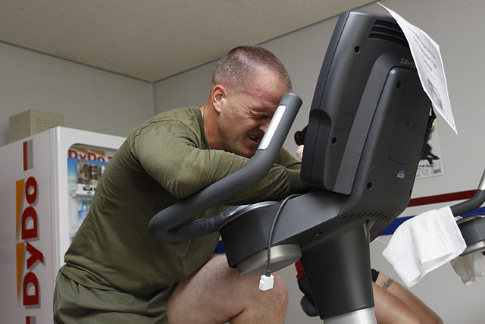
The city of Los Angeles wants to know if there is a connection between physical fitness and air pollution. Fifty volunteers from the mayor’s office agree to be tested. First, they are asked to ride a stationary bike for 1 hour in a pollution-free air chamber.
A week later, the volunteers return and are again asked to ride a stationary bike for 1 hour in a chamber filled with air pollutants common to Los Angeles. Their heart rates are monitored throughout the 1 hour bike rides.
Volunteers who breathed common polluted air
Name the control group _________________________________________________
Name the experimental group ____________________________________________
Name the independent variable __________________________________________
Name the dependent variable ____________________________________________
Volunteers who breathed clean air
Quality of air
Heart rates

Slide 20
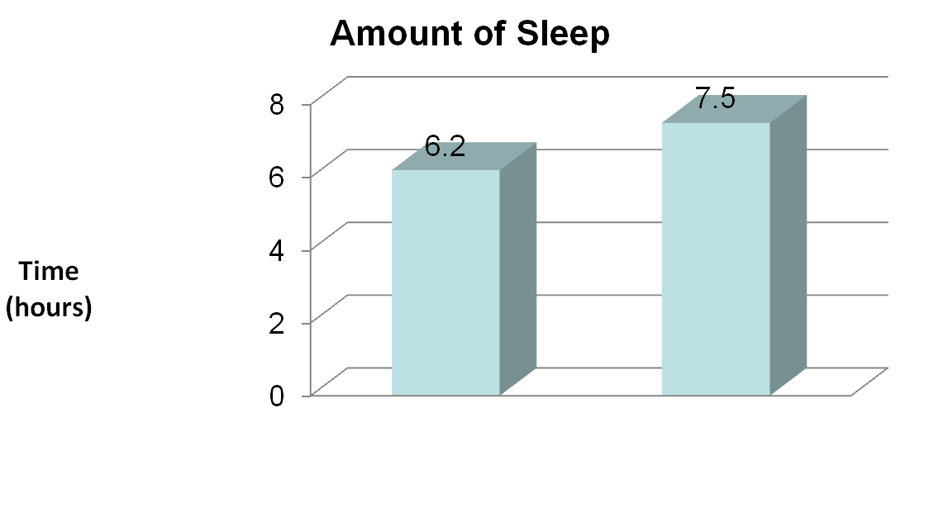
4th Step: Data Analysis
Without
music
With
music
Data from control group is compared to experimental group
Hypothesis is either supported or rejected
  Not “proven”

Slide 21
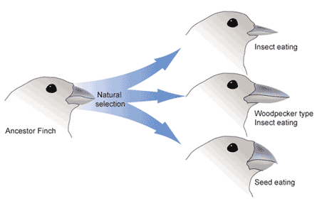
5th Step: Conclusion
Your findings could be shared and repeated by others
Theory develops over time
  Theory = long standing hypothesis
Theories and hypotheses change based on new information
Today, Darwin’s idea of “natural selection” is an accepted scientific theory…
but in 1859 is started as his hypothesis.

Slide 22
Review
Place the 5 steps of the scientific method in order from start to finish.
  Data analysis, Observation, Conclusion, Experimentation, Hypothesis
In which stage of the scientific method are graphs usually created?
In which stage of the scientific method are the two variables identified?
Which variable is the difference between the control and experimental group?
Which group of an experiment is used for comparison and contains no changes?
How many independent variables should exist in a well designed experiment?
What is the data collected from the independent variable called?
Vocabulary: Science, Scientific method, Hypothesis, Control group, Experimental group, Independent variable, Dependent variable, Theory

